Slide 1
Linux LPE with PAM
Doston Abdullayev

Slide 2
Linux Local Privilege Escalation (LPE)
Local Privilege Escalation (LPE) — attacker local user sifatida tizimda bo‘ladi
Maqsad: root yoki yuqori account olish
LPE post-exploitation bosqichi hisoblanadi
Linux sistemasida LPE ko‘pincha misconfiguration(noto’g’ri sozlash) sabab bo‘ladi Bilishimiz kerak bo’lgan asosiy tushuncha:
Initial access va LPE farqi
Nima uchun root access juda xavfli
Linux security model (users, groups, permissions)

Slide 3
LPE Hujum ketma-ketligi
Initial Access (ssh, web shell, stolen credentials)
Enumeration (Ma’lumot to’plash)
Privilege Escalation
Persistence (Qarshilik ko’rsatish)
Muxim:
Enumeration LPE ning eng muhim qismi
PAM enumeration doimiy tekshiriladi
Attack chain tushunchasi

Slide 4
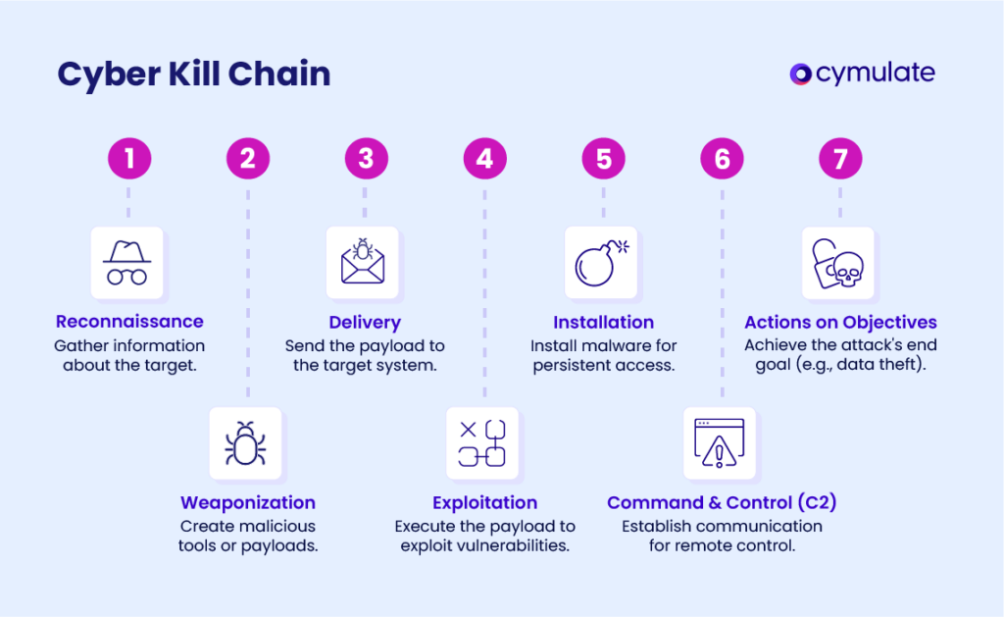

Slide 5
Odatiy bo’lgan Linux LPE texnikalari
SUID/SGID dasturlarni
Writable configuration files
Cron jobs abuse
Kernel exploits
PAM-based LPE
PAM LPE exploit yozishni talab qilmaydi
Logic va configuration xatolari asosida ishlaydi

Slide 6
PAM o’zi nima?
PAM — Pluggable Authentication Modules
Authentication, authorization, session management
Linux services PAM orqali user ni tekshiradi
Explanation points:
PAM nima uchun yaratilgan
Umumlashtirilgan authentication ning afzalliklari
PAM bo‘lmasa har bir service o‘z tasdiqlashni yozadi

Slide 7
PAM dan foydalanadigan serviclar
login
sshd
sudo
su
polkit
Muxim:
PAM system-level component
Bitta PAM xatosi bir nechta service ga ta’sir qiladi
sudo va su eng xavfli target

Slide 8
PAM arxitekturasi
Application → PAM library
PAM config file o‘qiladi
Modules ketma-ket bajariladi
Final decision qaytariladi
PAM stack tushunchasi
Module order juda muhim
Control flag flow

Slide 9
PAM Sozlamalar Lokatsiyasi
Slide content:
/etc/pam.conf (legacy)
/etc/pam.d/ (directory-based)
Service-based configuration
Har bir file service nomi bilan ataladi
sudo PAM config misoli
Include va substack lar

Slide 10
PAM Modullari
pam_unix.so – standard auth
pam_permit.so – always allow (hardoim ruxsat beradi)
pam_deny.so – always deny (hardoim taqiqlaydi)
pam_exec.so – external command (tashqaridagi commandalar)
pam_env.so – environment variables (atrof-muhit o’zgaruvchilari)
.so — shared object
Module ning xavfi argumentlarga bog‘liq

Slide 11
PAM sababli bo’lishi mumkin bo’lgan LPE
Authentication bypass (tasdiqlashni aylanib o’tish)
Authorization bypass
Root access without password (parolsiz root huquqi)
PAM exploit emas
Admin xatosi hujumchiga yordam beradi

Slide 12
Yozish huquqi bo’lgan PAM risk
/etc/pam.d/* root-only bo‘lishi kerak
Writable file — critical finding
Attackers pam_permit qo‘shadi
chmod va chown muhim
File butunligini monitoring zarur

Slide 13
PAM Enumeration
File ruxsatlarini tekshirish kerak
Xavfli modullarni qidirish kerak
Maxsus servicga aloqador xizmatlarni qidirish kerak Commandalarga misollar:
ls -l /etc/pam.d/
grep pam_permit /etc/pam.d/*
grep pam_exec /etc/pam.d/*

